Slide 1
Programming Machine Learning Applications
Lecture Three: Proximity and the k-Nearest-Neighbors Algorithm
Dr. Aleksandar Velkoski

Slide 2
Review of Lecture Two
Types of Datasets
Instances & Features
Interactive Workshop

Slide 3
Lecture Three
Proximity
k-Nearest-Neighbor Classifier
Interactive Workshop

Slide 4
Proximity

Slide 5
Similarity - Dissimilarity - Proximity
Similarity
Numerical measure of how alike two features are
Value is higher when instances are more … ?
Dissimilarity
Numerical measure of how different two features are
Value is higher when instances are more … ?
Proximity can refer to similarity of dissimilarity

Slide 6
Why is it Important?
Data Mining Tasks
Clustering
k-Nearest-Neighbor search, classification, and prediction
Characterization and Discrimination
Automatic Categorization
Correlation Analysis
Real-world Applications
Personalization
Recommender Systems
Document Categorization
Information Retrieval
Target Marketing

Slide 7
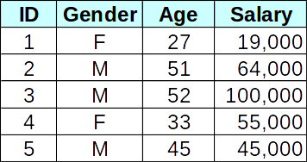
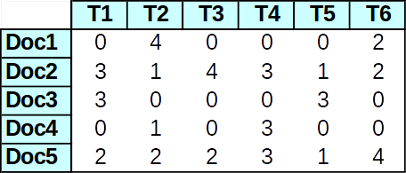
Measuring Proximity
In order to group similar items, we need a way to measure proximity
It often requires the representation of objects as feature vectors
Employee DB
Term Frequencies

Slide 8
Properties
For all objects A and B, dist(A, B) >= 0, and dist(A, B) = dist(B, A)
For any object A, dist(A, A) = 0
dist(A, C) <= dist(A, B) + dist (B, C)

Slide 9
Representation
Each object can be viewed as an n-dimensional vector, where the dimensions are the features in the data
Example (employee DB): <M, 51, 64000>
Example (documents): <3, 1, 4, 3, 1, 2>
The vector representation allows us to compare proximity between pairs of items using standard vector operations

Slide 10
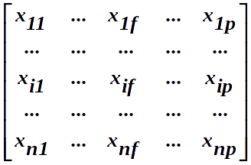
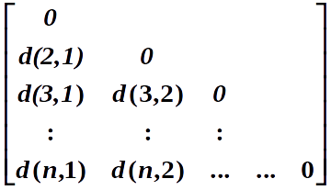
Data Matrix and Distance Matrix
Notes:
Conceptual representation of a table. n data points and p dimensions. Vector representation of data.
N data points, but indicates only pairwise distance. A triangular matrix. Symmetric.

Slide 11

Nominal Features
m: # of matches, p: total # of variables

Slide 12
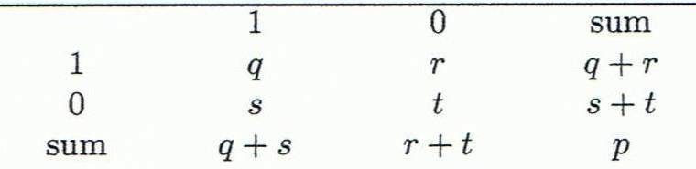
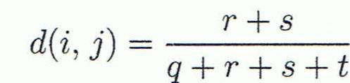
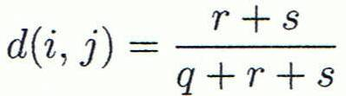
Binary Features
Contingency Table
Symmetric
Asymmetric

Slide 13



Numeric Features
Consider two vectors:
Manhattan Distance
Euclidean Distance

Slide 14
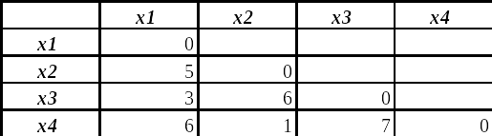
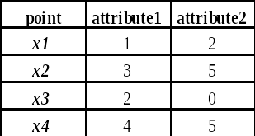
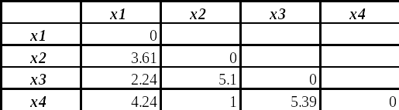
Numeric Example
Manhattan
Data Matrix
Euclidean

Slide 15
Minkowski Distance
Minkowski Distance
where i = (xi1, xi2, …, xip) and j = (xj1, xj2, …, xjp) are two p-dimensional data objects, and h is the order (the distance so defined is also called L-h norm)
Note: Euclidean and Manhattan Distances are special cases of Minkowski

Slide 16

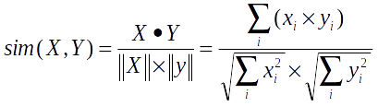
Vector Based Measures
In some situations, distances measures provide a skewed view of data
Dot product of vertices:
Cosine Similarity = Normalized Dot Product

Slide 17
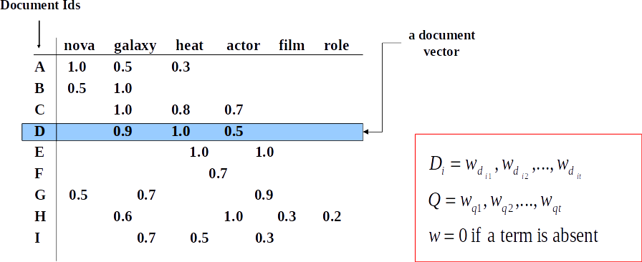
Example: Information Retrieval
Documents are represented as “bags of words” (vectors when used computationally)
A vector is an array of floating point (or binary in case of bit maps)
Has direction and magnitude
Each vector has a place for every term in collection (most are sparse)

Slide 18
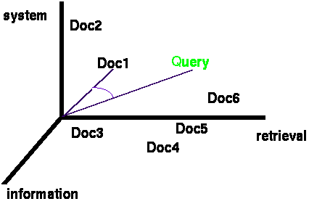
Documents and Queries
Documents are represented as vectors in term space
Typically values in each dimension correspond to the frequency of the corresponding term in the document
Queries represented as vectors in the same vector-space
Cosine similarity between the query and documents is often used to rank retrieved documents

Slide 19
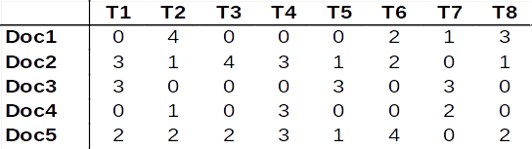
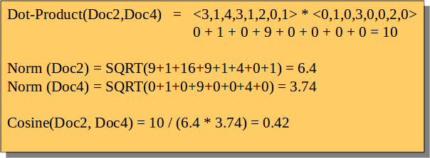
Example: Document Similarities

Slide 20

Correlation as Similarity
In cases where there could be high mean variance across objects, Pearson is used
Often used in recommender systems based on Collaborative Filtering

Slide 21
Distance-Based Classification
Classify new instances based on similarity to instances we’ve seen before.
Simplest form of MBR (Minimum Bounding Rectangle): Rote Learning
Learning by memorization
Save all previously encountered instances; given a new instance, find one from the memorized set that most closely “resembles” the new one; assign new instance to the same class as the “nearest neighbor”
More general methods try to find “k” nearest neighbors
Challenges
How do we define “resembles”?

Slide 22
k-Nearest Neighbors

Slide 23
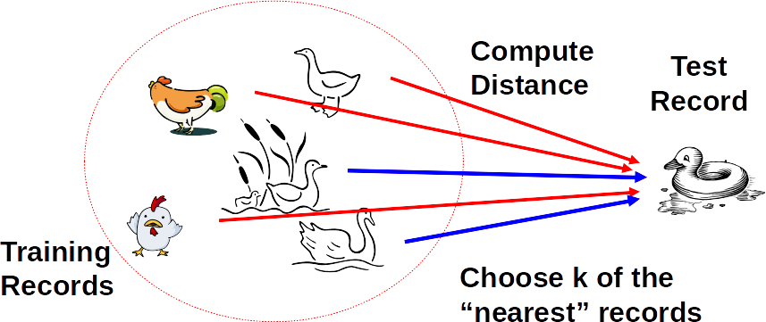
kNN Classifier
If it walks like a duck, quacks like a duck, then it’s probably a duck

Slide 24
kNN Strategy
Given object x, find the k most similar objects to x
The k nearest neighbors
Variety of distance or similarity measures can be used to identify and rank neighbors
Note that this requires comparison between x and all objects in the database
Classification
Find the class label for each of the k neighbor
Use a voting or weighted voting approach to determine the majority class among the neighbors (a combination function)
Weighted voting means the closest neighbors count more
Assign the majority class label to x
Prediction
Identify the value of the target attribute for the k neighbors
Return the weighted average as the predicted value of the target attribute for x

Slide 25
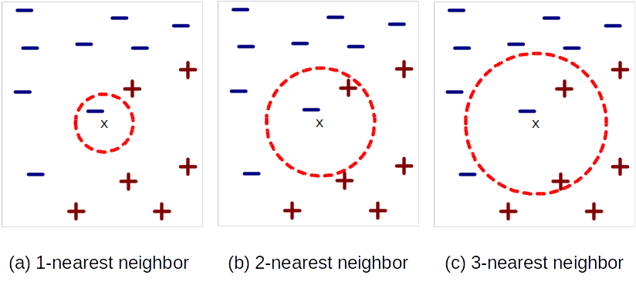
kNN Strategy

Slide 26
Combination Functions
Voting: the “democracy” approach
poll the neighbors for the answer and use the majority vote
the number of neighbors (k) is often taken to be odd in order to avoid ties
works when the number of classes is two
if there are more than two classes, take k to be the number of classes plus 1
Impact of k on predictions
in general different values of k affect the outcome of classification
we can associate a confidence level with predictions (this can be the % of neighbors that are in agreement)
problem is that no single category may get a majority vote
if there is strong variations in results for different choices of k, this an indication that the training set is not large enough

Slide 27
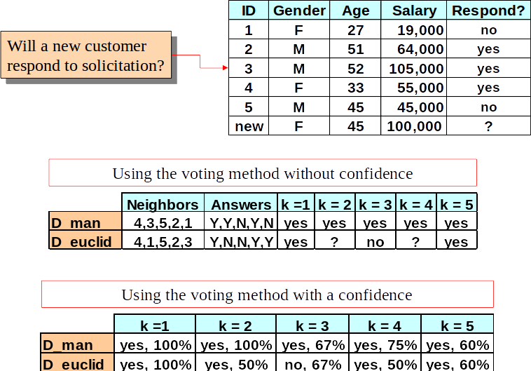
Voting Approach

Slide 28
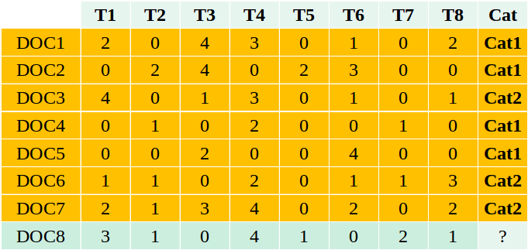
Document Categorization

Slide 29
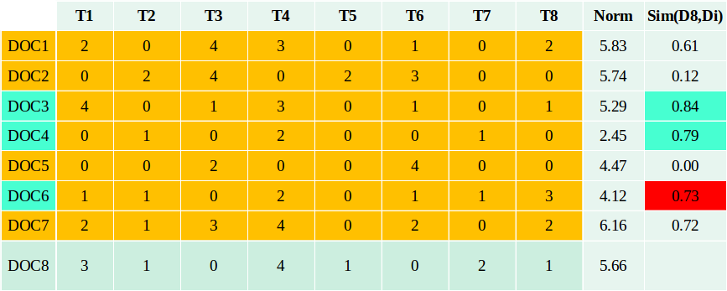
Document Categorization
Sim(D8,D7) = (D8 * D7) / (Norm(D8).Norm(D7))
= (3x2+1x1+0x3+4x4+1x0+0x2+2x0+1x2) / (5.66 x 6.16)
= 25 / 34.87 = 0.72

Slide 30
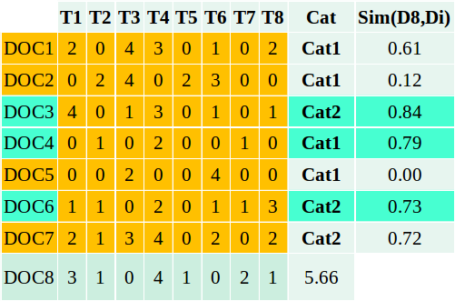
Document Categorization
Simple voting:
Cat for DOC 8 = Cat2 with confidence 2/3 = 0.67
Weighted voting:
Cat for DOC 8 = Cat2
Confidence: (0.84 + 0.73) / (0.84 + 0.79 + 0.73) = 0.66

Slide 31
Combination Functions
Weighted Voting: not so “democratic”
similar to voting, but the vote some neighbors counts more
“shareholder democracy?”
question is which neighbor’s vote counts more?
How can weights be obtained?
Distance-based
closer neighbors get higher weights
“value” of the vote is the inverse of the distance (may need to add a small constant)
the weighted sum for each class gives the combined score for that class
to compute confidence, need to take weighted average
Heuristic
weight for each neighbor is based on domain-specific characteristics of that neighbor
Advantage of weighted voting
introduces enough variation to prevent ties in most cases
helps distinguish between competing neighbors

Slide 32
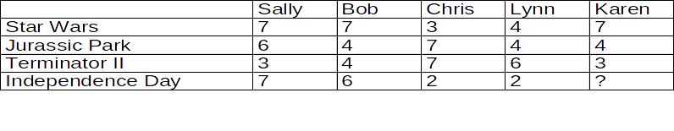
Example: Collaborative Filtering
Movie Rating SYstem
Rating Scale: 1 = “hate it”; 7 = “love it”
Historical DB of users includes ratings of movies
Karen is a new user who has rated 3 movies, but has not yet seen “Independence Day”; should we recommend it to her?

Slide 33
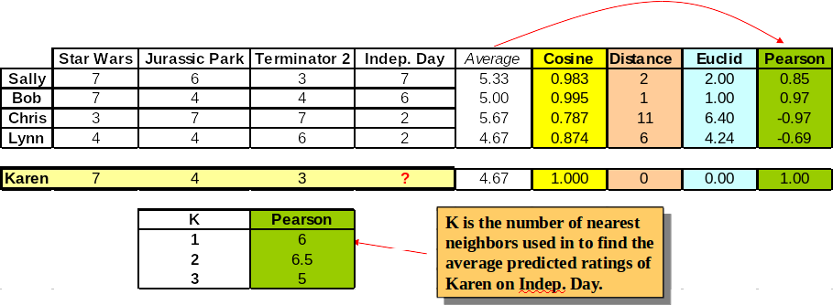
Example: Collaborative Filtering
Pearson(Sally, Karen) = ( (7-5.33)*(7-4.67) + (6-5.33)*(4-4.67) + (3-5.33)*(3-4.67) )
/ SQRT( ((7-5.33)2 +(6-5.33)2 +(3-5.33)2) * ((7- 4.67)2 +(4- 4.67)2 +(3- 4.67)2)) = 0.85

Slide 34
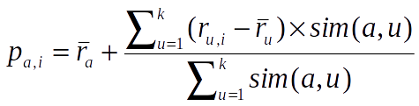
Collaborative Filtering
In practice a more sophisticated approach is used to generate the predictions based on the nearest neighbors
To generate predictions for a target user a on an item i:
ra = mean rating for user a
u1, …, uk are the k-nearest-neighbors to a
ru,i = rating of user u on item I
sim(a,u) = Pearson correlation between a and u
This is a weighted average of deviations from the neighbors’ mean ratings (and closer neighbors count more)

Slide 35
Questions
Wrapping-up the Lecture

Slide 36
What is the difference between a data and distance matrix?

Slide 37
What is the intuition behind k-Nearest-Neighbors Classifier?

